Slide 1
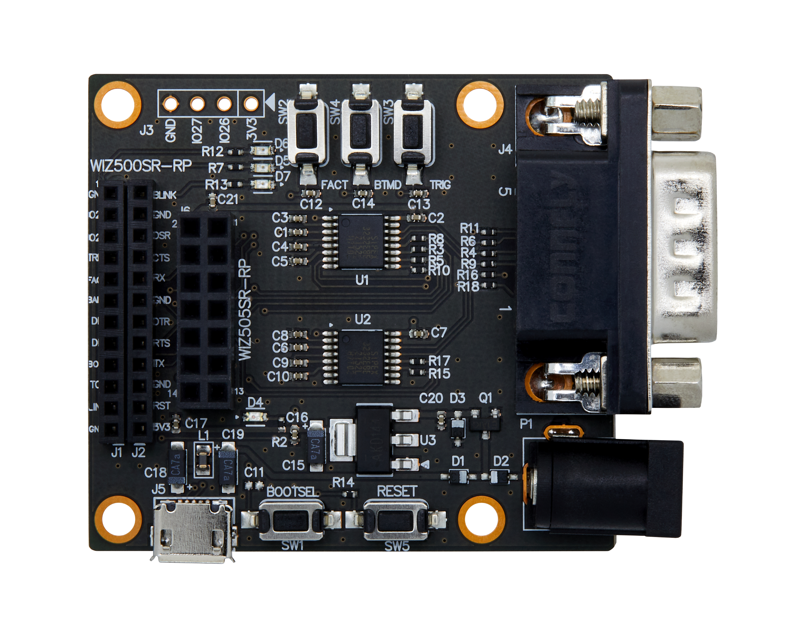

Slide 2
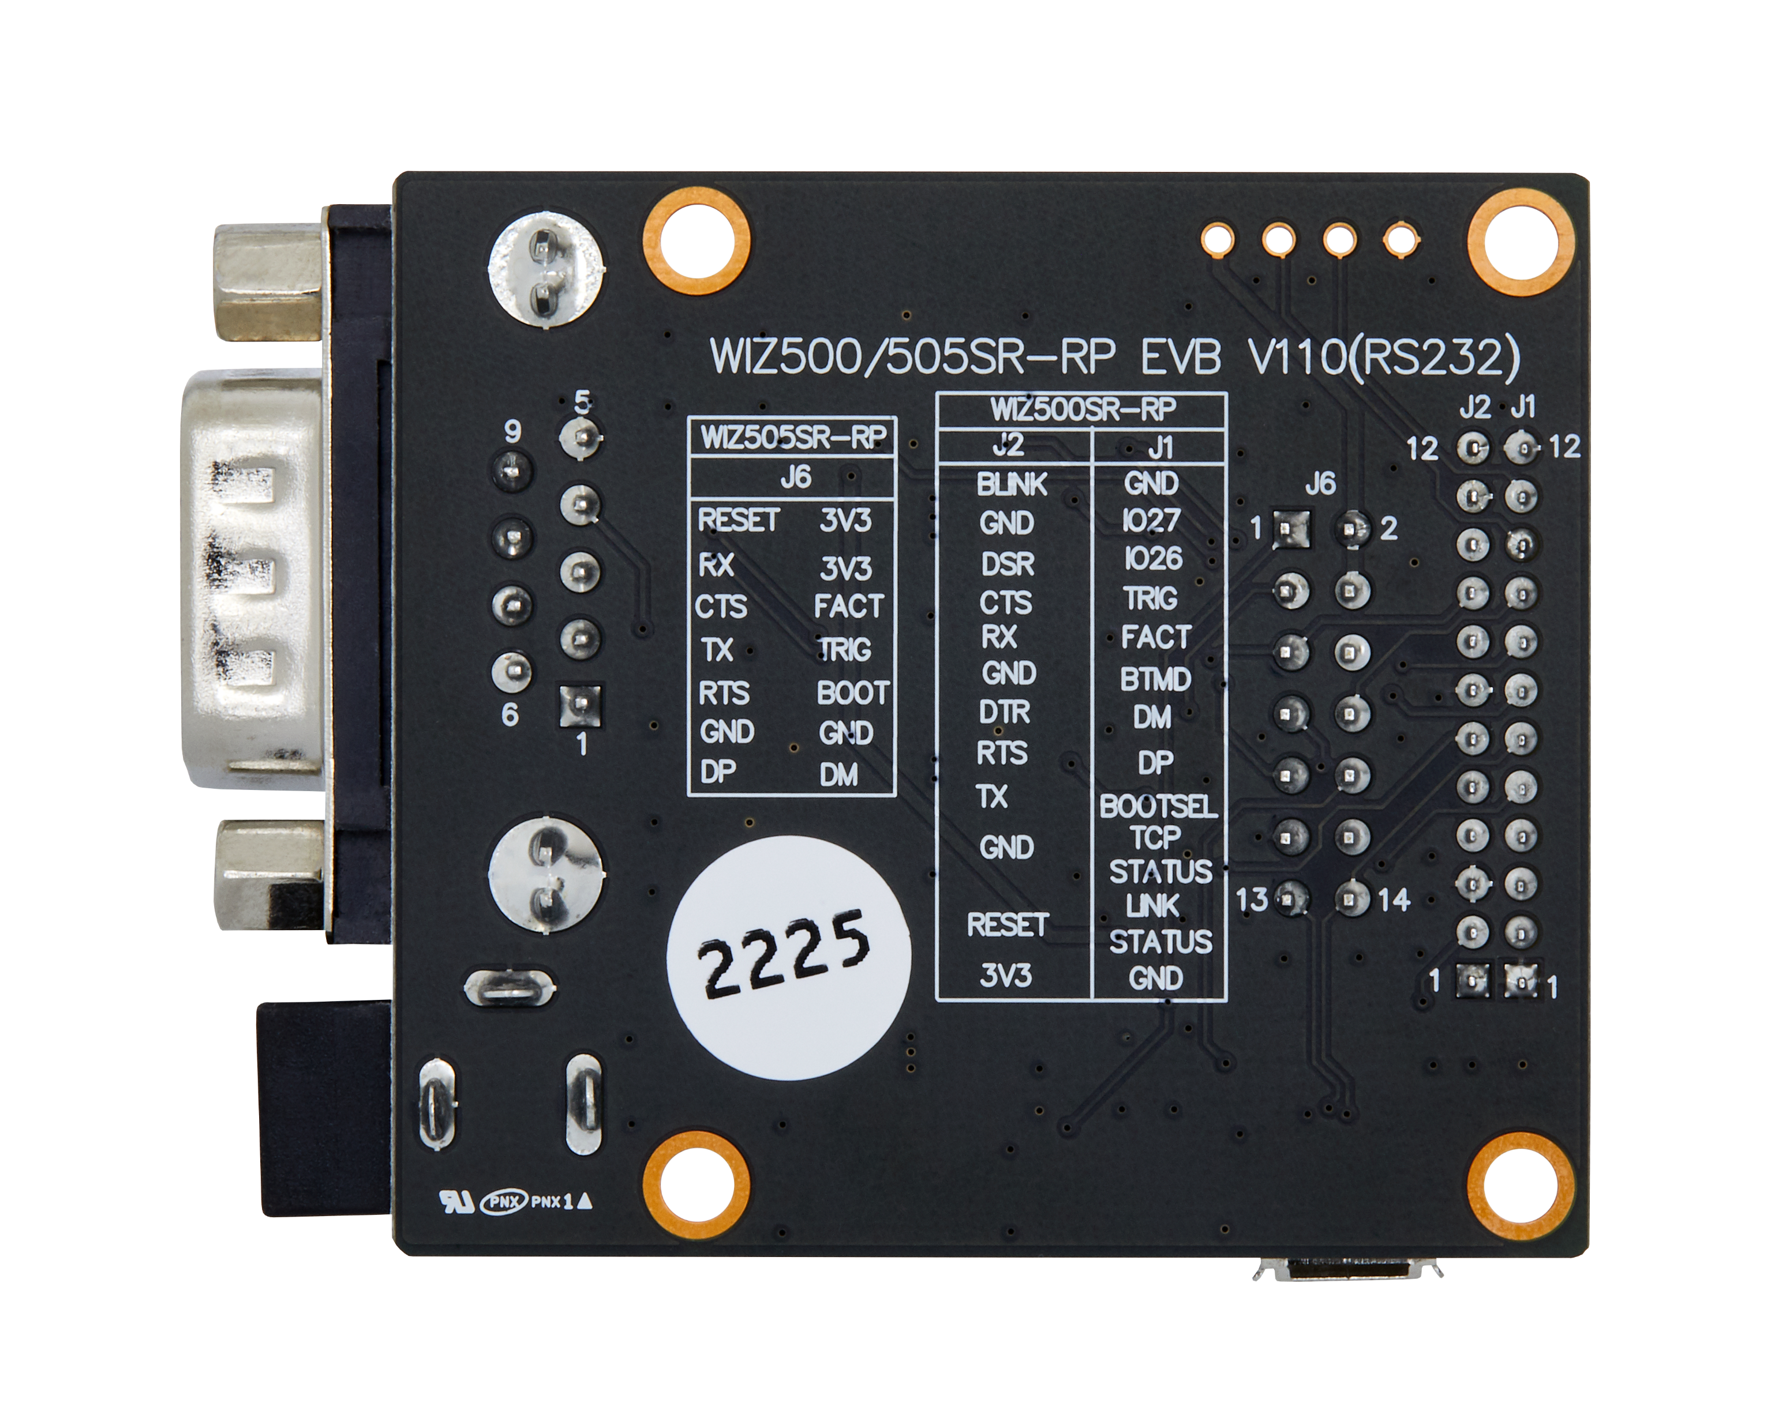

Slide 3
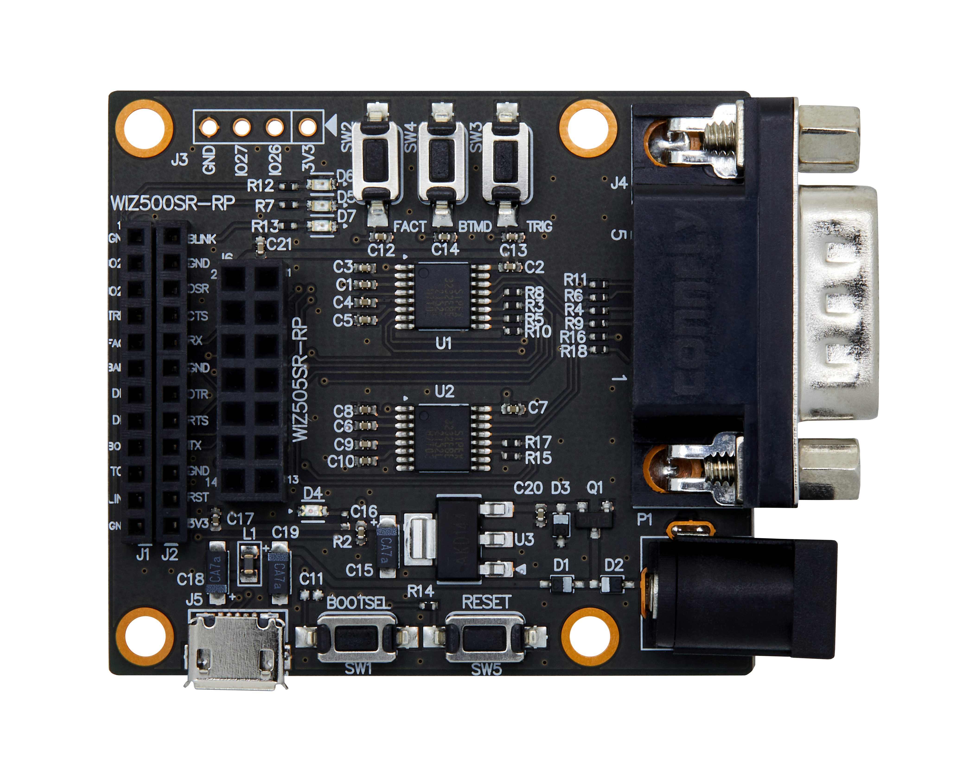
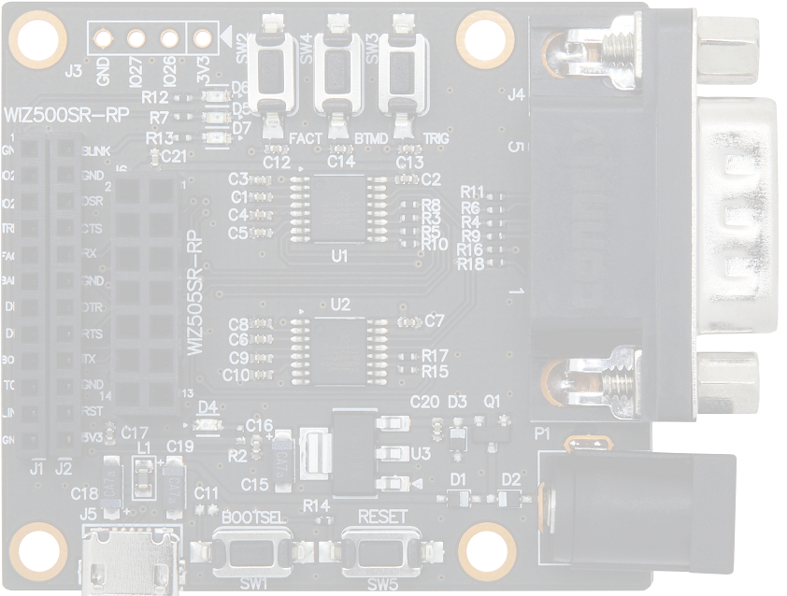
J1
Header
J2
Header
J4
DB9

Slide 4
J1
Header
J2
Header
J4
DB9

Slide 5
J1
Header
J2
Header
J4
DB9

Slide 6
J1
Header
J2
Header
J4
DB9

